Slide 1
MITT-ILC WECANX 2.0
Lighting Locations

Slide 2
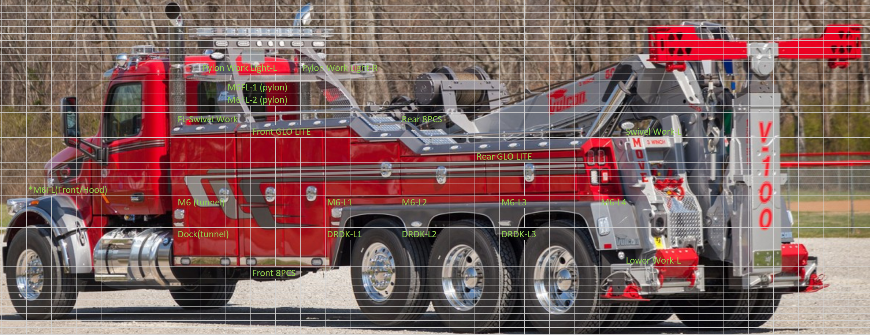
Configuration 1 Lighting Locations (V100)

Slide 3
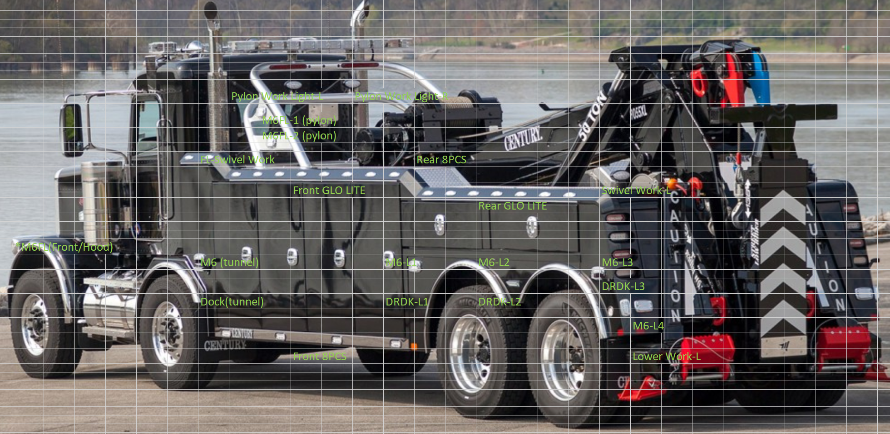
Configuration 1 Lighting Locations (9055XL)

Slide 4
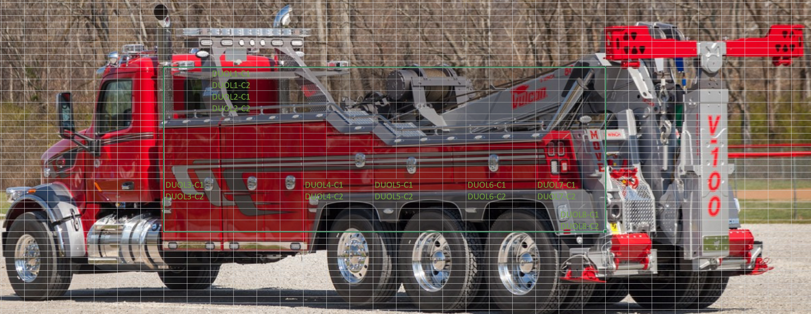
Configuration 2 Lighting Locations (V100)

Slide 5
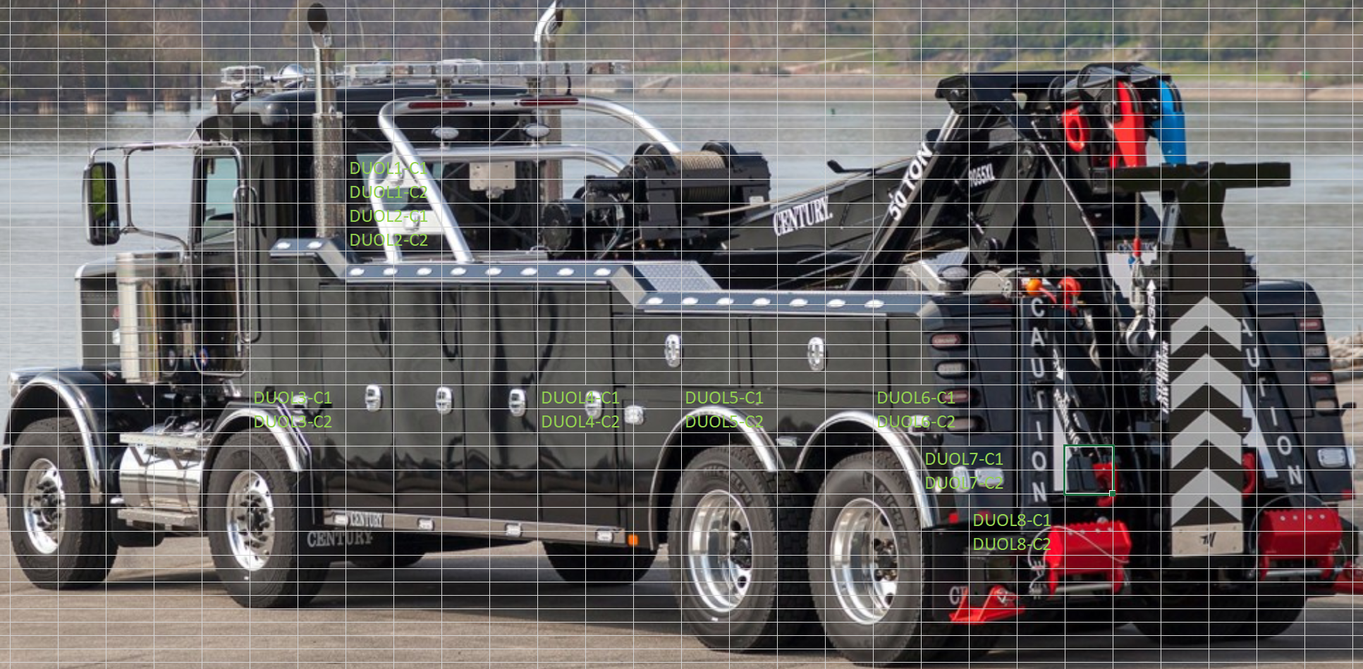
Configuration 2 Lighting Locations (9055XL)

